Slide 1
Crop production Analysis – India
Presented by: Aditya Raj
Company: Unified mentor
Project: 3rd

Slide 2
agenda
Objective & Introduction
Data validation and Transformation
Data Insertion
Dashboarding
Profitable Insights
Conclusion

Slide 3
Objective & introduction
The Agriculture business domain, as a vital part of the overall supply chain, is expected
to highly evolve in the upcoming years via the developments, which are taking place on
the side of the Future Internet. This paper presents a novel Business-to-Business
collaboration platform from the agri-food sector perspective, which aims to facilitate the
collaboration of numerous stakeholders belonging to associated business domains, in an
effective and flexible manner.

Slide 4
Data validation & Transformation
There were many data points which were incorrect. For example the production of coconut was very high, which is not possible in practicality. Therefore, the coconut data was entirely removed as it wasn’t correctable.
There were plenty of null values in the dataset, those null values were completely removed.
The “Area” and “Production” column did not specified the units. So, I took the most commonly used units as base. Hectare was used for “Area” and tonnes was used for “Production”
The datatype of “Year” column was changed to date.
The data contained many outliers. Those were removed for better representation.

Slide 5
Data Insertion
The initial data set was insufficient for analyzing crop production trends and generating insights.
Additional columns were introduced to enhance the analysis.
A "Productivity" column was created using the formula "Production / Area.“
A "Category" column was added to classify crops into their respective categories.
A "Region" column was incorporated to segment states according to their geographical locations.

Slide 6
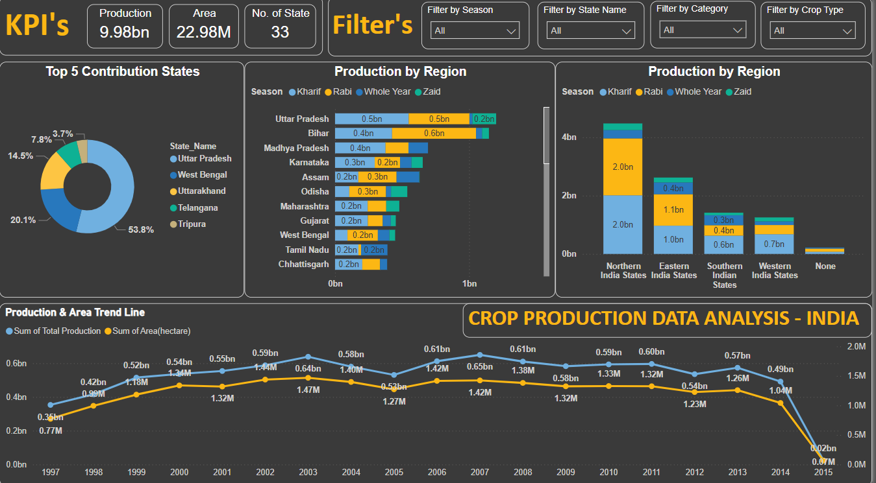
Dashboarding

Slide 7
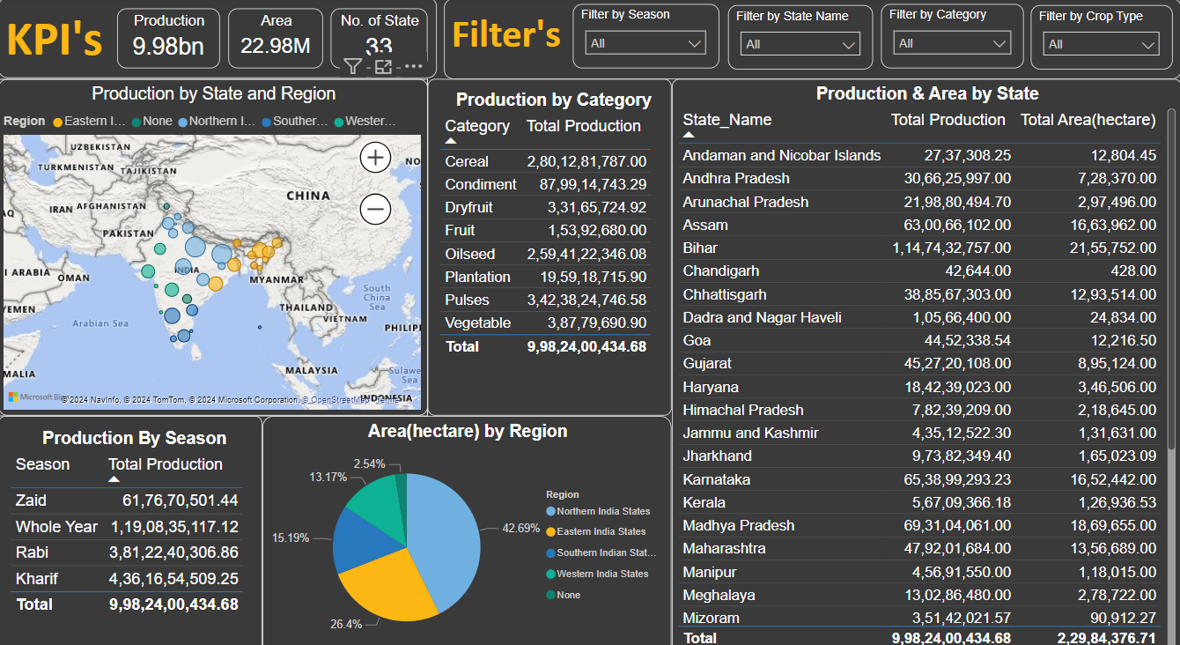
Dashboarding

Slide 8
Profitable insights
General Insights:
Total Production: The total crop production is reported as 9.98 billion units (possibly in tons or similar metric).
Total Area: The total area used for crop production is 22.98 million hectares.
Number of States: Data is gathered from 33 states across India.
Top 5 Contribution States:
Uttar Pradesh is the largest contributor, accounting for 53.8% of the total production among the top 5 states.
West Bengal comes next, contributing 20.1%.
Uttarakhand, Telangana, and Tripura contribute 14.5%, 7.8%, and 3.7% respectively.
Production by Region and Season:
Northern India States dominate in production with a total of 4 billion units. The production is almost evenly split between Kharif and Rabi seasons.
Eastern India States follow with a significant contribution of 1.1 billion units, where the Whole Year category (production throughout the year) makes up the majority.
Southern India States and Western India States have lower production levels, but still contribute significantly.

Slide 9
Profitable insights
Production by Region and Season:
Northern India States dominate in production with a total of 4 billion units. The production is almost evenly split between Kharif and Rabi seasons.
Eastern India States follow with a significant contribution of 1.1 billion units, where the Whole Year category (production throughout the year) makes up the majority.
Southern India States and Western India States have lower production levels, but still contribute significantly.
Production & Area Trend Line:
The trend line shows fluctuations in both production and area from 1997 to 2015:
The production peaked around 2010 with 0.61 billion units but started to decline afterward, reaching a low of 0.02 billion in 2015.
The area cultivated peaked in 2004 at 1.47 million hectares but similarly declined, reaching nearly zero in 2015.
Production by Category:
Cereals are the most produced category with 2.80 billion units.
Vegetables and Pulses also have significant production levels, contributing 3.87 million and 3.42 million units, respectively.
Dryfruit and Fruit have the lowest production volumes.

Slide 10
Profitable insights
Production by Season:
Whole Year cultivation is the most productive with 1.19 billion units.
Kharif and Rabi seasons are also significant, contributing 4.36 billion and 3.81 billion units, respectively.
Zaid season, a short season between Rabi and Kharif, contributes 61.76 million units.
Regional Insights:
Northern India is the powerhouse of agriculture in India, leading both in terms of production and the area used for cultivation.
Eastern India also shows strong agricultural productivity, particularly with crops that are grown year-round.
Area by Region:
Northern India States utilize the largest area (hectares), accounting for 42.69% of the total area.
Eastern India States come second, followed by Southern India States and Western India States.

Slide 11
Conclusion
﻿﻿Across all metrics, Sum of Area(hectare) had the most interesting recent trend and started trending down on 2011, falling by 94.94% (12,57,897.00) in 4 years.﻿﻿
﻿﻿Sum of Total Production was trending up between 2000 and 2010 with a rise of 5,65,58,996.96 but had a significant change in trend and dropped by 57,24,26,864.07 starting 2011.﻿﻿
﻿﻿Sum of Area(hectare) dropped from 13,24,980.00 to 67083 during its steepest decline between 2011 and 2015.﻿﻿
﻿﻿Uttar Pradesh accounted for 53.84% of Sum of Total Production.﻿﻿
﻿﻿Kharif had the highest total Sum of Total Production at 4,36,16,54,509.25, followed by Rabi, Whole Year, and Zaid.﻿﻿
﻿﻿Bihar in Season Rabi made up 6.27% of Sum of Total Production.﻿﻿
﻿﻿Kharif had the highest average Sum of Total Production at 13,21,71,348.77, followed by Rabi, Zaid, and Whole Year.﻿﻿
﻿Uttar Pradesh in Region Northern India States made up 12.03% of Sum of Total Production.
Northern India States accounted for 42.69% of Sum of Area(hectare).
﻿Sum of Total Production (93.27% decrease) and Sum of Area(hectare) (91.33% decrease) both trended down between 1997 and 2015.﻿﻿

Slide 12
Thank you
GitRepo: https://github.com/CycloTronAR/Crop-Production-Analysis-India

